Slide 1

Restaurant Ordering App
Alsalt Alkharusi and Yaqoob Al Farsi

Slide 2
Proceedings
Project Scope
Objectives
Phases of Project
Architecture Design
Activity Diagram
Application Interfaces

Slide 3
Project Scope
Allocation of approximately all restaurants on the map
Updated Menu of restaurants
Placing order to appropriate restaurant
Pay through an online service
Receiving invoice from the restuarant

Slide 4
Objectives
Easy approach to place order
Quick service by restaurants
Deliver fresh food to customers(s) at their doorstep
Secure way to pay online and increasing customer satisfaction

Slide 5
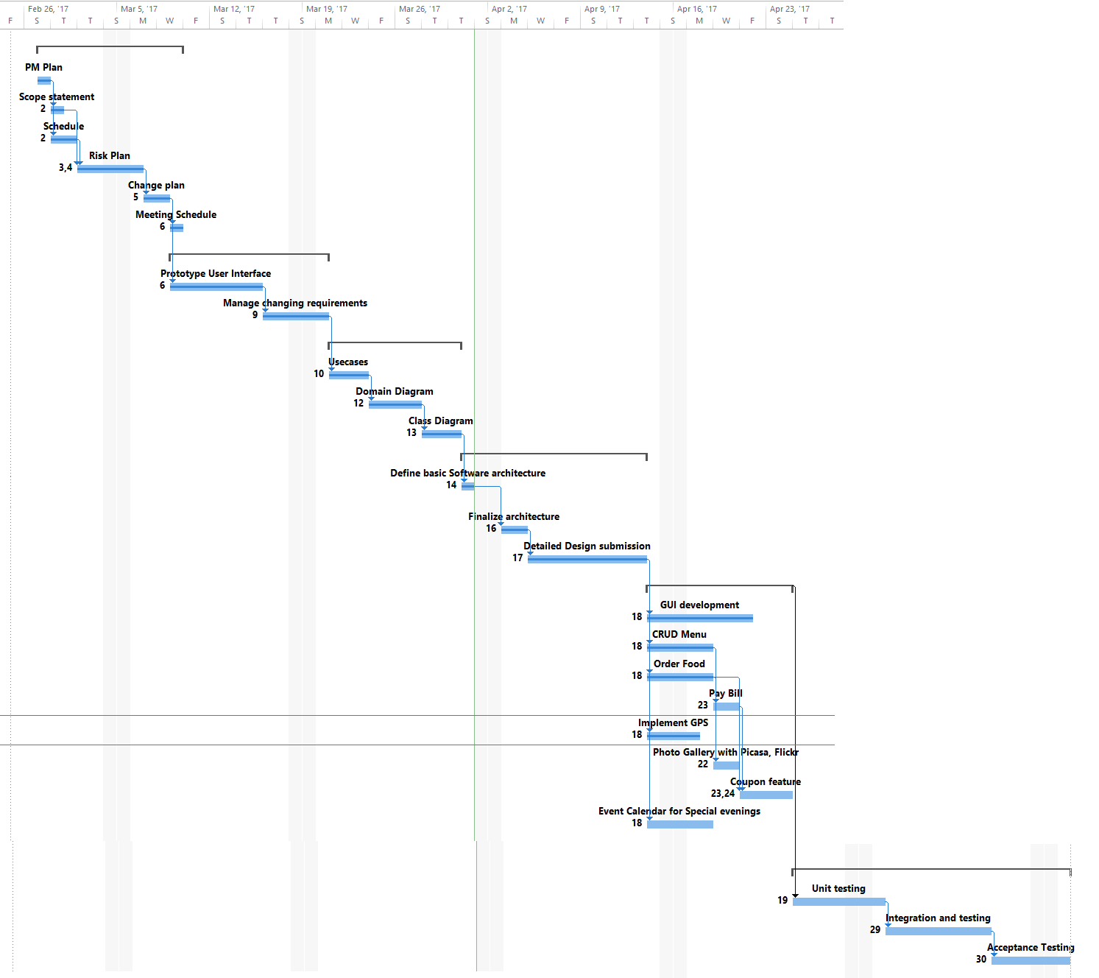
PHASES OF PROJECT

Slide 6
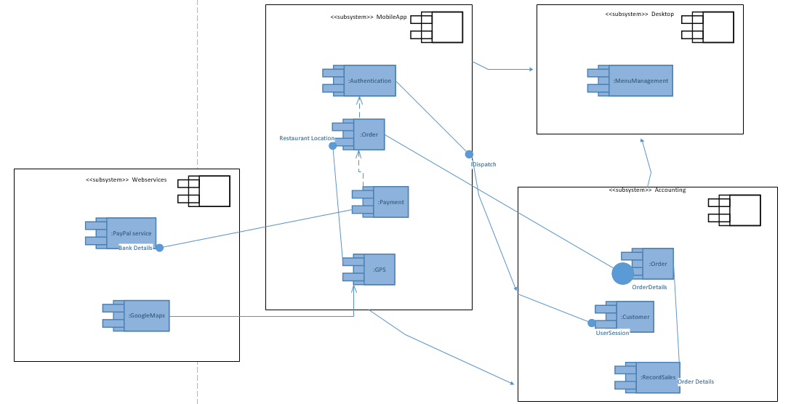
Architecture Diagram – Component Based
Notes:
The application is divided into 4 main modules : Webservices, MobileApp module , Desktop module and the accounting module
Mobile contains 4 components the AUTHENTICATION , order payment and GPS. Authentication component require data about customer’s accounts. Order component sends the order details to the component of an accounting module
PAYMENT is dependent upon ORDER
ORDER requires data about restaurant location, hence it connect with GPS, GPS component is dependent upon GOOGLEMAPS webservice of the module WEBSERVICES
RECORD SALES component of the ACOOUNTING module requires data related to ORDERS
The WEBSERVICES in this system are PAYPAL and GOOGLE MAPS

Slide 7
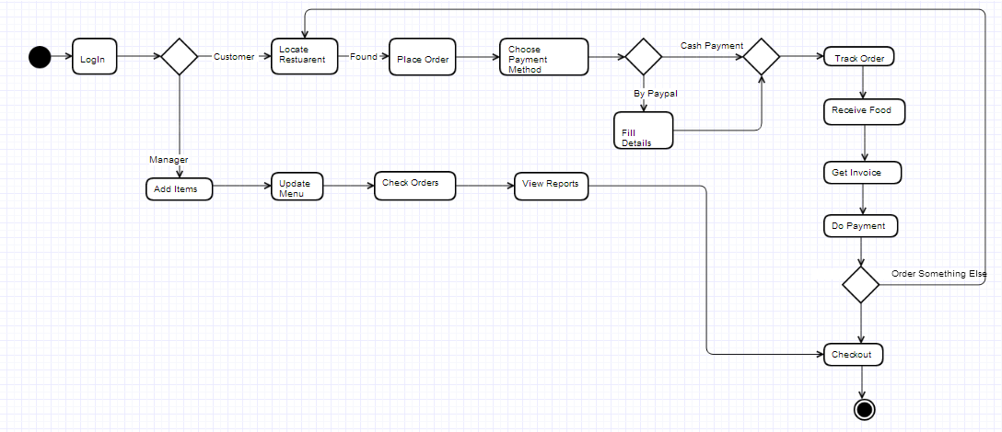
Activity Diagram

Slide 8
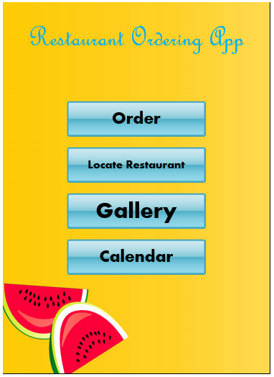
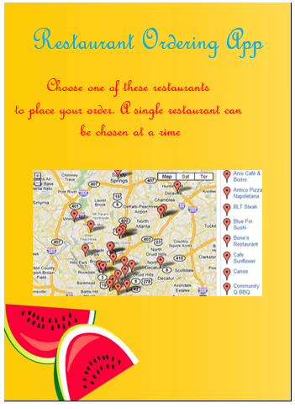
LOCATE RESTAURANT GUI

Slide 9
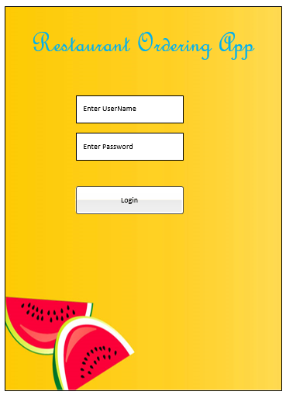
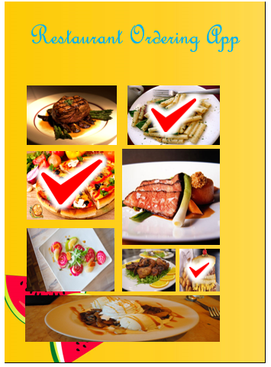
PLACE ORDER GUI

Slide 10
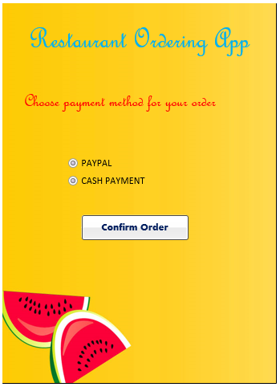
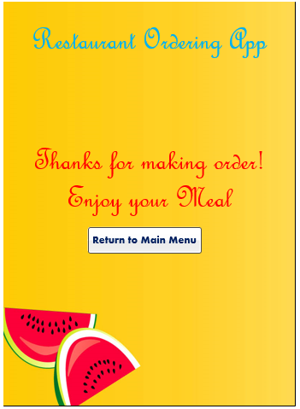
SELECT PAYMENT METHOD GUI

Slide 11
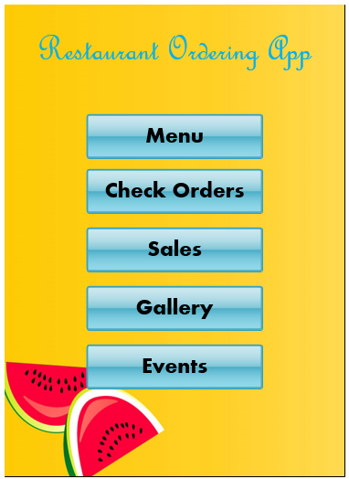
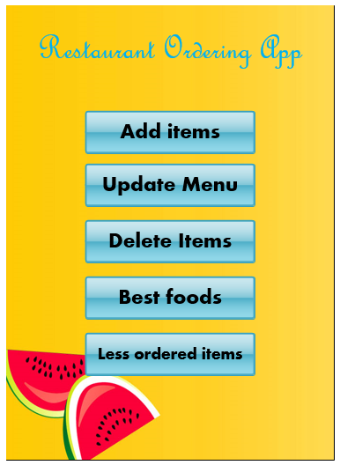
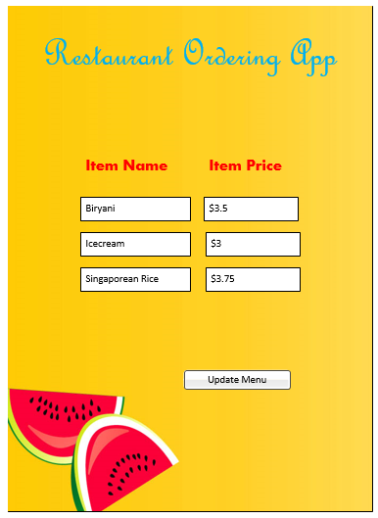
SELECT ITEM GUI

Slide 12
UPDATE MENU GUI

Slide 13
Any Questions ?

Slide 14
Thank You Have a Nice Day ☺

